Slide 1
10 Bits of Surprise: Detecting Malicious Users with Minimum Information
Date: 2015/11/19
Author: Reza Zafarani, Huan Liu
Source: CIKM '15
Advisor: Jia-ling Koh
Spearker: LIN,CI-JIE

Slide 2
Outline
Introduction
Method
Experiment
Conclusion

Slide 3
Introduction
Malicious users are a threat to many sites and defending against them demands innovative countermeasures
In June 2012, Facebook reported that 8.7% of its user accounts are fake
Twitter claims that 5% of its users are fake

Slide 4
Challenges
Malicious users need to be detected using their often limited content or link (i.e. friends) information
Existing techniques assume that a good amount of information about malicious users has been gathered

Slide 5
Introduction
Goal:
develop a methodology that identifies malicious users with limited information
using usernames as the minimum information available on all sites

Slide 6
Outline
Introduction
Method
Experiment
Conclusion

Slide 7
Malicious Users are Complex and Diverse
Malicious users often generate (1) complex and (2) diverse information to ensure their anonymity

Slide 8
Complexity
Information surprise
For a rare username u with a small observation probability p(u), information surprise I(u) is much higher than that of a common username
To estimate the probability of a username using an n-gram model

Slide 9
Diversity
The number of digits in the username
The proportion of digits in the username

Slide 10
Malicious Users are Demographically Biased
Malicious User Gender
decomposes a username into character n-grams
estimates the gender likelihood based on these n-grams
the classifier's confidence in the predicted gender as the feature
Malicious User Language
detect the language of the username
train an n-gram statistical language detector over the European Parliament Proceedings Parallel Corpus, which consists of text in 21 European languages
the alphabet distribution of the username

Slide 11
Malicious Users are Demographically Biased
Malicious User Knowledge
the vocabulary size can be computed by counting the number of words in a large dictionary that are substrings of the username

Slide 12
Malicious Users are Anonymous
entropy of the alphabet distribution of the username
normalize entropy
the number of unique letters used in the username divided by the username length

Slide 13
Malicious Users are Similar
Language Patterns
the normalized character-level bigrams of usernames
the number of digits at the beginning of the username
the maximum number of times a letter has been repeated in the username

Slide 14
Malicious Users are Similar
Word Patterns
two dictionaries, one containing keywords related to malicious activities and the other for offensive key-words
count the number of words in the dictionary that appear as the substring of the username

Slide 15
Malicious Users are Efficient
the username length
the number of unique alphabet letters in usernames

Slide 16
Malicious Users are Efficient
DVORAK and QWERTY keyboards
The percentage of keys typed using the same hand that was used for the previous key
The percentage of keys typed using the same finger that was used for the previous key
The percentage of keys typed using each finger
The percentage of keys pressed on rows: Top Row, Home Row, Bottom Row, and Number Row
The approximate distance (in meters) traveled for typing a username

Slide 17
Malicious user detection with minimum information
Supervised learning can be performed using classification or regression

Slide 18
Outline
Introduction
Method
Experiment
Conclusion

Slide 19
DataSet
Malicious Users (negative examples)
Collect malicious usernames from sites such as dronebl.org, ahbl.org
32 million usernames
Normal Users (positive examples)
Collect normal users usernames from Twitter
45,953 usernames
Facebook Users (positive+negative examples)
158 million usernames
Facebook expects around 1.5% to be malicious
Gender Dataset
4 million Facebook usernames for which we have the gender information

Slide 20
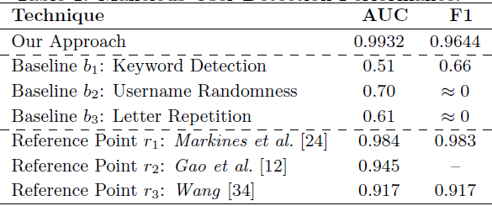

Slide 22
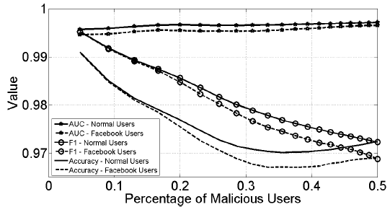

Slide 23
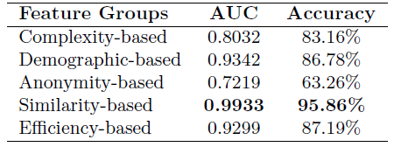

Slide 24
Outline
Introduction
Method
Experiment
Conclusion

Slide 25
Conclusion
Introduced a methodology that can identify malicious users with minimum information
Identify five general characteristics of malicious users

Slide 26
Thanks for listening

